Slide 1

REAL TIME FACE MASK DETECTOR
Major Project Seminar On
Department Of Computer Science And Engineering
Under the esteemed Guidance of
Chaithanya Sree
Designation : Asst . Professor
Department : CSE
Batch No : 4
Name: K. Mounika -17P61A0593
G.Prabhavathi-17P61A0563
K.Rahul-17P61A0594
K .Sandhya Rani-17P61A05A4

Slide 2
Abstract
The use of face masks is very necessary to prevent and limit the spread of certain respiratory viral diseases, including COVID-19. Face mask can be used to protect either healthy people or prevent infection by infected persons . In order to check whether a person wears a face mask or not, we need a computer vision system and Deep Learning algorithm that is able to perform this type of detection. This project uses a Deep Neural Network, more specifically Convolutional Neural Network, to differentiate between images of people with and without masks.
The CNN manages to get an accuracy of 98.6% on the training set and 97.3% on the test set. Then the stored weights of this CNN are used to classify as mask or no mask, in real time.The webcam capturing the video, the frames are preprocessed and fed to the model to accomplish this task. The model works efficiently with no apparent lag time between wearing/removing mask and display of prediction.

Slide 3
Literature survey
As one of the most successful applications of image analysis and understanding, face recognition has recently received significant attention, especially during the past few years.
This is evidenced by the emergence of face recognition conferences such as the International Conference on Audioand Video-Based Authentication (AVBPA) since 1997 and the International Conference on Automatic Face and Gesture Recognition (AFGR) since 1995.
The systematic empirical evaluations of face recognition techniques (FRT), including theFERET [Phillips et al. 1998b, 2000; Rizvi et al. 1998], FRVT 2000 [Blackburn et al.2001], FRVT 2002 [Phillips et al. 2003], and XM2VTS [Messer et al. 1999] protocols, and many commercially available systems (Table II).
There are at least two reasons for this trend; the first is the wide range of commercial and law enforcement applications and the second is the availability of feasible technologies after 30 years of research.
In addition, the problem of machine recognition of human faces continues to attract researchers from disciplines such as image processing, pattern recognition, neural networks, computer vision, computer graphics, and psychology.The strong need for user-friendly systems that can secure our assets and protect our privacy without losing our identity in.[1998].

Slide 4
Introduction
The use of face masks is very necessary to prevent and limit the spread of certain respiratory viral diseases, including COVID-19. Face mask can be used to protect either healthy people or prevent infection by infected persons .
In order to check whether a person wears a face mask or not, we need a computer vision system and Deep Learning algorithm that is able to perform this type of detection.
This project uses a Deep Neural Network, more specifically Convolutional Neural Network, to differentiate between images of people with and without masks.
The CNN manages to get an accuracy of 98.6% on the training set and 97.3% on the test set. Then the stored weights of this CNN are used to classify as mask or no mask, in real time.
The webcam capturing the video, the frames are preprocessed and fed to the model to accomplish this task. The model works efficiently with no apparent lag time between wearing/removing mask and display of prediction.

Slide 5
Objective
To study face detection and recognition techniques.
To design a system that can detect and recognize faces in real time.
Simulate the algorithms and obtain result using CNN (Convolutional Neural Network ) of Deep Learning.

Slide 6
Problem Statement
The objective is to find the best face recognition model with less memory utilization and low processing from servers possible i.e, millions of images can be processed much faster by segmentation, multithreading or parallel processing. Also explore and test best computational models like CNN (Convolutional neutral network),DNN (deep neutral network).

Slide 7
System Requirement
SOFTWARE REQUIREMENTS Languages Used:
1.Python 2.Open-cv, Deep learning libraries. 3.Anaconda HARDWARE REQUIREMENTS 1.RAM:- 4.00GB 2.Hard Disk:- 8GB 3. Operating System :- 64bit

Slide 8
Existing System
Face Mask detection models have many variations. These can be divided into several categories. In Boosting-based classification, boosted cascades with easy haar features were embraced using the Viola-Jones face detector.
Then a Multi-view face mask detector was made motivated by the Viola-Jones detector model. In addition to this, a face mask detector model was made using decision trees algorithms. Face mask detectors in this category were very effective in detecting face masks

Slide 9
Proposed System
The proposed system focuses on how to identify the person on image or video stream wearing face mask with the help of computer vision and deep learning algorithms.
We will build a “Real time face mask detector” CNN (Convolutional Neural Network) .
CNN(Convolutional Neural Network) is one of the best one-stage object detection models that has proven to work well with dense and small scale object, for this reason it has become a popular object detection model.

Slide 10
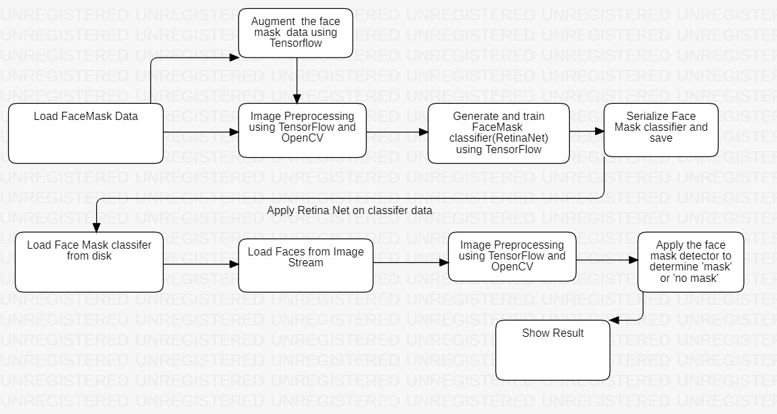
Flow chart

Slide 11
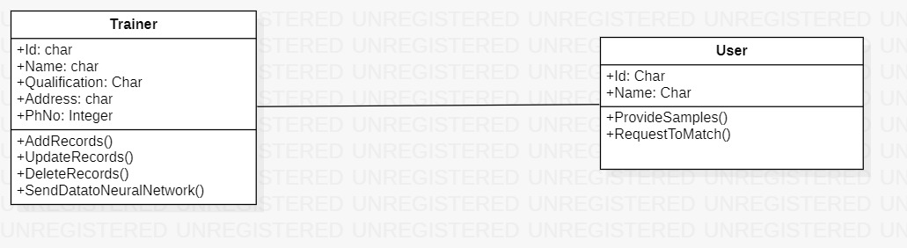
Class Diagram

Slide 12
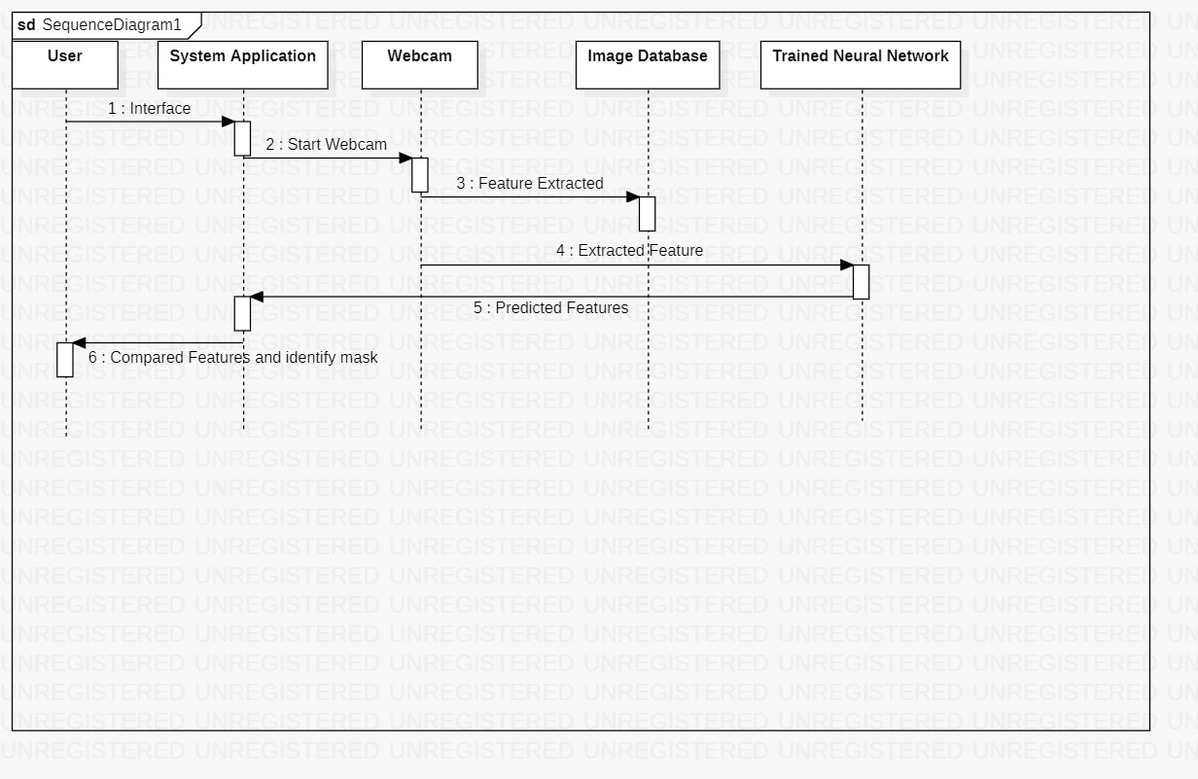
Sequence Diagram

Slide 13
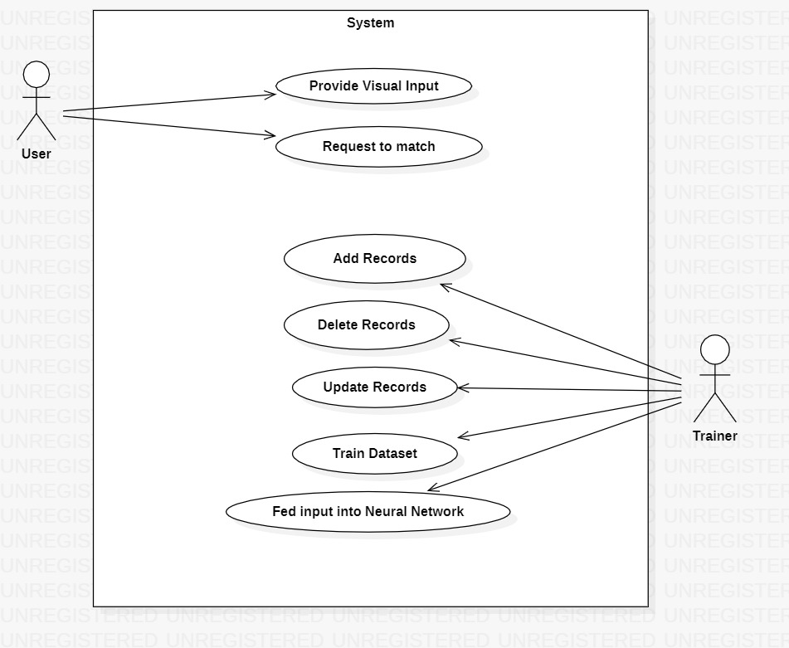
Use case Diagram

Slide 14
IMPLEMENTATION
Faster CNN is most widely used state of the art version of the CNN family. These networks usually consist of A region proposal algorithm to generate “bounding boxes” or locations of possible objects in the image.
A feature generation stage to obtain features of these objects, usually using a CNN. c) A classification layer to predict which class this object belongs.
A regression layer to make the coordinates of the object bounding box more precise.
Fast CNN used CPU based selective search algorithm for region proposal, which takes around 2 s per image and runs on CPU computation.
The Faster CNN paper fixes this by using Region Proposal Network (RPN) to generate the region proposals.
This not only brings down the region proposal time from 2 s to 10 ms per image but also allows the region proposal stage to share layers with the following detection stages, causing an overall improvement in feature representation.

Slide 15
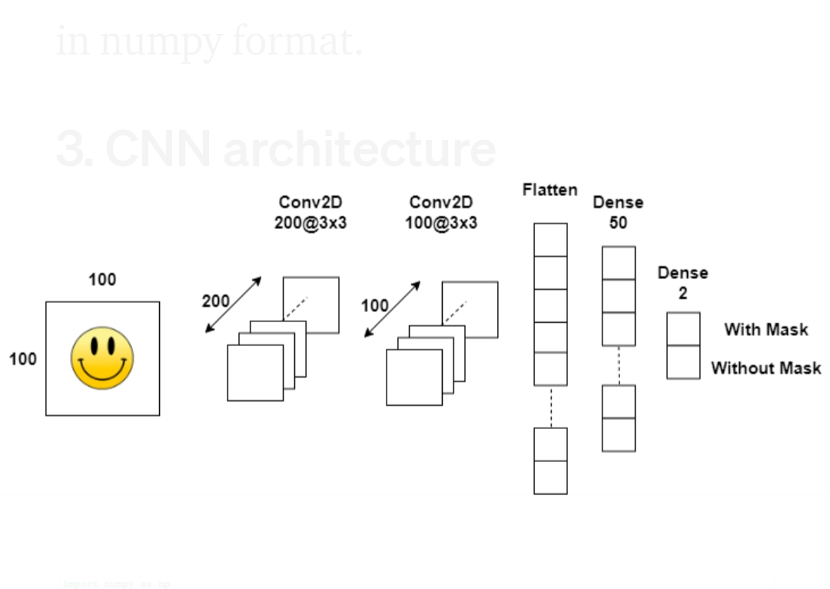
TRAINING CNN
Our CNN has to has two Convolutional layer. We are importing 100 images. Our first convolutional layer has200 corneal of 3x3 and second convolutional layer has 100 corneal of 3x3.
Flatten all the convolutional we are going to get from convolutional layer.
Finally it will be connected to dense layer of 50 neuron and last will be our output layer which is having 2 neuron.

Slide 16
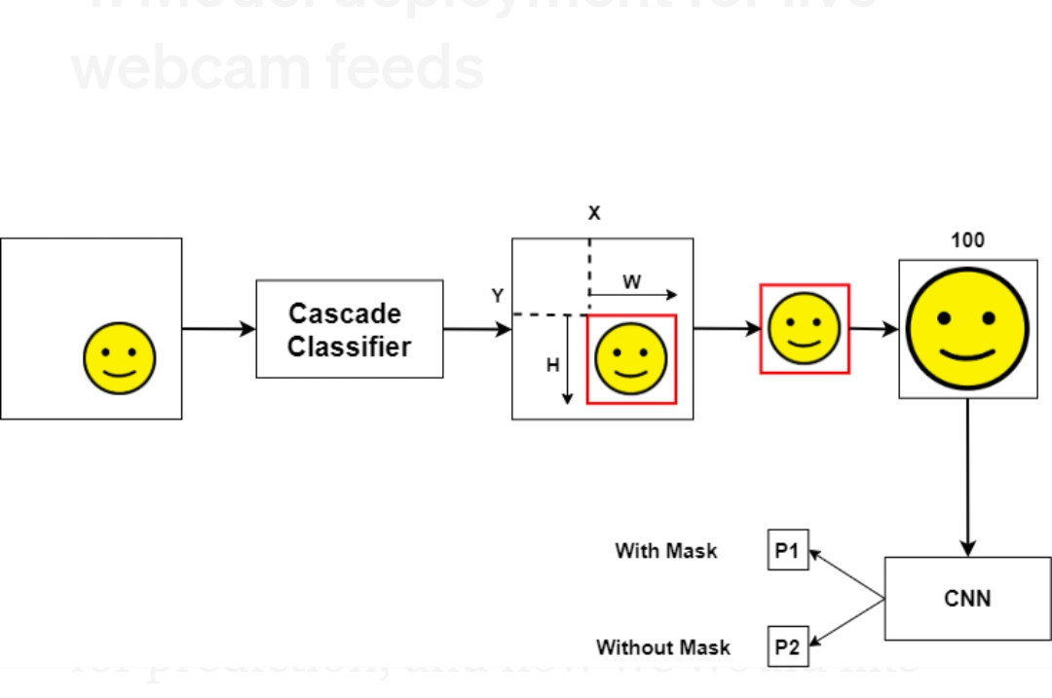
DEPLOYMENT PHASE
First, we will take the face from the webcam. Then it will go for cascading classifiers will get the output from classifiers the output is the reason for the interesting face which is a size of (100 px).
After that this face will send to our trained CNN model then it will show the output like a person wear a mask or not.

Slide 17
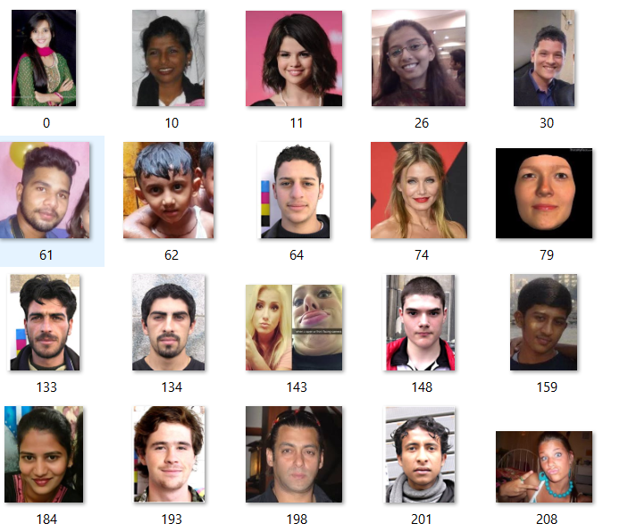
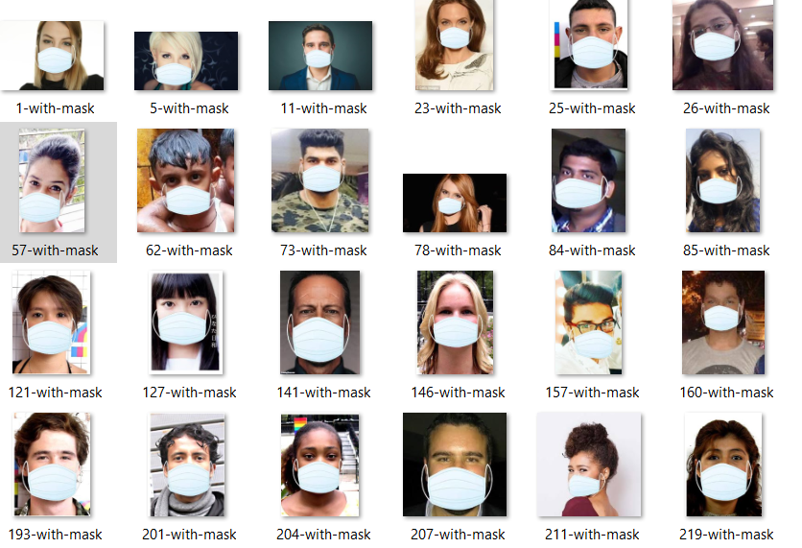
TEST CASES
For the test cases we have taken lots of faces from the different positions and different countries.
Test cases mean with different types of faces like male and female data, different countries people with and without masks.

Slide 18

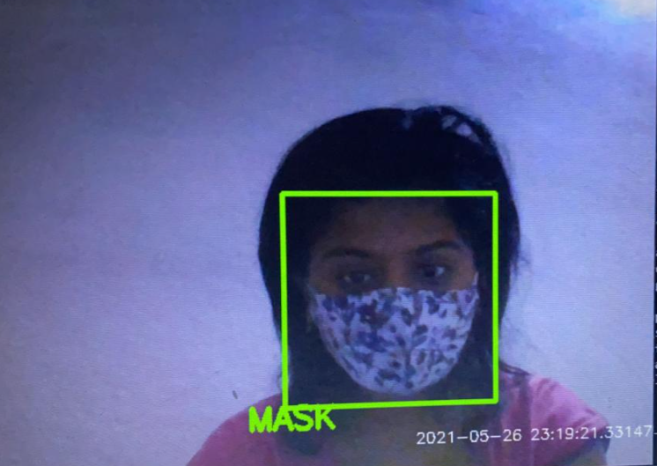
RESULT SCREENSHOT
A person without face mask.
A person with face mask.

Slide 19
Future scope of the project
1.Currently, the model gives 5 FPS inference speed on a CPU. In the future we plan to improve this up to 15 FPS.
2.The use of machine learning in the field of mobile deployment is rising rapidly. Hence ,we plan to port our models to their respective Tensor Flow lite versions.
3.Point 1 and point 2 models can be easily replaced with improved models in the future that would give better accuracy and lower latency.

Slide 20
About Dataset
As we know any deep learning model would require a large volume of training data to give good results on test data. So we use “Web Scrapping” method to gather a large volume of images for this deep learning project.
After gathering image data we used a tool “Labellmg” for creating annotations for training and validation dataset.
.So the dataset consists of 2000 images with 1050 images containing images of people wearing mask and 950 images with people without masks.

Slide 21
CONCLUSION
As the technology are blooming with emerging trends the availability so we have novel face mask detector which can possibly contribute to public healthcare.
The architecture consists of Retina Net as the backbone it can be used for high and low computation scenarios. In order to extract more robust features, we utilize transfer learning to adopt weights from a similar task face detection, which is trained on a very large dataset.

Slide 22
References
[1] P. A. Rota, M. S. Oberste, S. S. Monroe, W. A. Nix, R. Campagnoli, J. P. Icenogle, S. Penaranda, B. Bankamp,
K. Maher, M.-h. Chenet al., “Characterization of a novel coronavirus associated with severe acute
respiratorysyndrome,”science, vol. 300, no. 5624, pp. 1394–1399, 2003.
[2] Z. A. Memish, A. I. Zumla, R. F. Al-Hakeem, A. A. AlRabeeah, and G. M. Stephens, “Family cluster of
middleeast respiratory syndrome coronavirus infections,”New England Journal of Medicine, vol. 368, no. 26,
pp.2487–2494, 2013.
[3] Y. Liu, A. A. Gayle, A. Wilder-Smith, and J. Rocklöv, “The reproductive number of covid-19 is higher
comparedto sars coronavirus,”Journal of travel medicine, 2020.
[4] Y. Fang, Y. Nie, and M. Penny, “Transmission dynamics of the covid-19 outbreak and effectiveness of
governmentinterventions: A datadriven analysis,”Journal of medical virology, vol. 92, no. 6, pp. 645–659, 2020.

Slide 23
Thank you

